Slide 1
About Company
Microtech Stampings incorporated in 2025. Located in Pune India, We Specialize in manufacturing high-precision, customized press metal components designed to meet the exacting demands of modern industries. We deliver components that combine accuracy, durability and cost efficiency and quality at every stage from raw material to final inspection. Elsewhere the business Manufacturing, Marketing, Trading, Selling, Purchasing, Importing, Exporting etc. for Metal components.
The Company’s Manufacturing Unit:- Gat No 742, Near Laxmi Park ,Gaikwad DP Road Kadamwak Wasti. Tal- Haveli, Dist. Pune, Pin- 412201
Vision
To be Globally trusted partner in precision metal press components, driving innovation, reliability, and engineering excellences
Mission
Manufacturer high-quality customized components with unwavering precision.
Embrace advanced technologies to ensure efficiency and cost- effectiveness.
Delivery on-time , consistent performance to build lasting customer partnerships.
Uphold sustainable practices and strive for continuous improvement.

Slide 2
Excellence
We deliver uncompromising quality and precision through advance technology, rigorous inspection, and a commitment to continuous improvement.
Innovation
We embrace advanced manufacturing techniques and smart engineering solutions to create high- performance metal components that meet evolving industry needs.
Sustainability
We Optimizing resources and reducing waste to ensure responsible and sustainable manufacturing.
Client Satisfaction
We build lasting partnerships by delivering precise, reliable components on time and providing responsive, customer- focused support at every stage.
Global Reach
We serve both domestic and international markets, supplying precision metal components that meet global quality and performance standards.

Slide 3
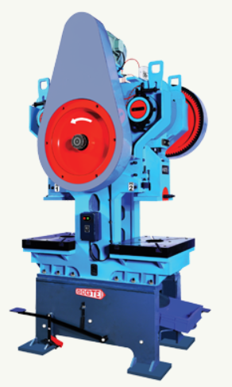
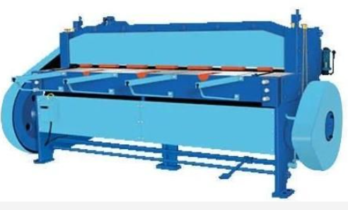
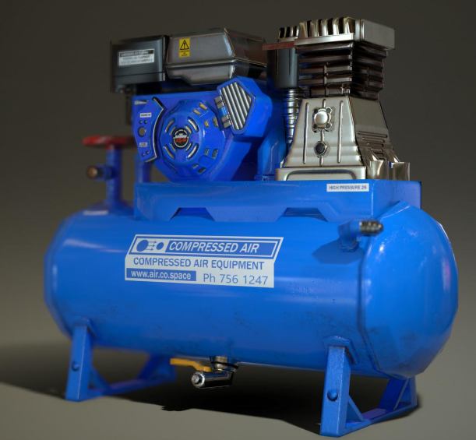
Machines
M/C Name:- C Type Duplex Mechanical power press. Capacity:- 30 Ton
Quantity:- 2
M/C Name:- Mechanical Shearing Machine.
Cutting Capacity:- 1250X2mm
Quantity:- 1
M/C Name:- Air compressor.
Cutting Capacity:- 2HP
Quantity:- 1

Slide 4
M/C Name:- C Type Duplex Mechanical power press.
Capacity:- 30 Ton
Quantity:- 2
1.
M/C Name:- Mechanical Shearing Machine.
Cutting Capacity:- 1250X2mm
Quantity:- 1
2.
M/C Name:- Air compressor.
Cutting Capacity:- 2HP
Quantity:- 1
3.

Slide 5
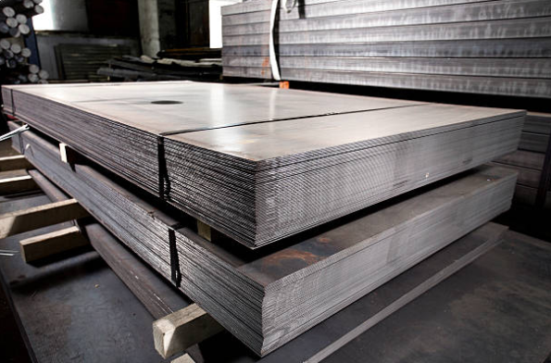
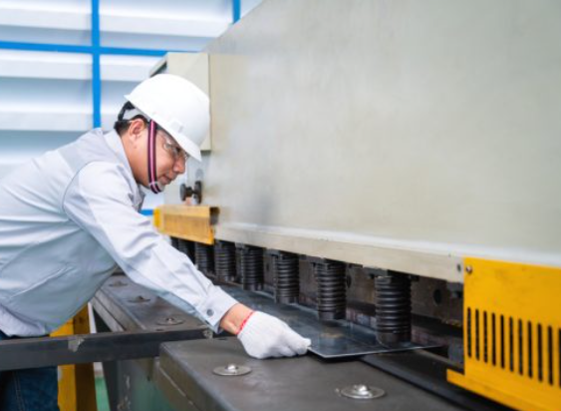
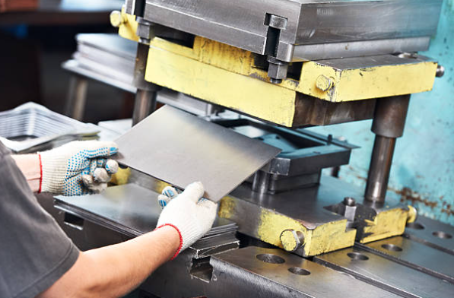
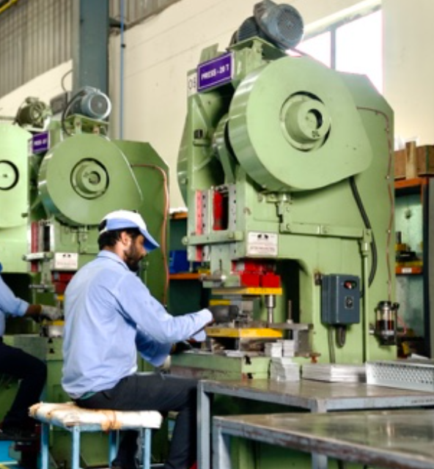
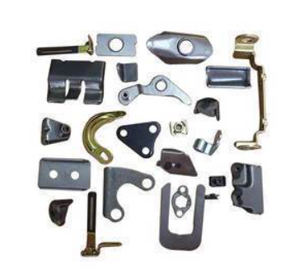
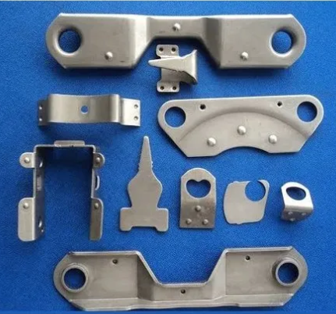
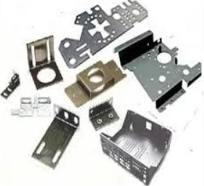
Process
2. Cutting Metal Sheet by Shearing Machine
3. Operating Matel Sheet on Press Machine
1. Raw Material ( Metal Sheet )
4. Operator Operating Press Machine
5. Metal Press Parts

Slide 6
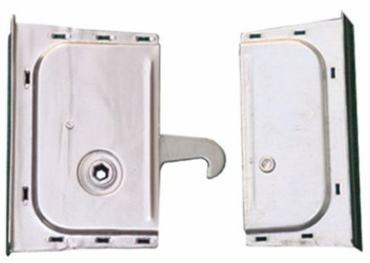




Our Products
Metal Cam lock for Cold Room Panel
High Quality, Strength and Durability.
Design for Easy Installation.
Excellence Insulation Performance.
Precise Locking Mechanism.
High Quality, Strength
and Durability
Excellence Insulation Performance
Meets the required standard
Easy to Installation
Microtech’s Camlock is Corrosion- resistant GI Material and Built to withstand heavy load and frequent use, Engineered with precision for Consistent Performance
Microtech’s Camlock Design for the easy Installation and Disassembly and made with quality material
And cost-effective, Saving time during setup
Microtech’s Camlock ensures airtight panel locking to prevent thermal leakage and Maintains uniform temperature inside cold rooms, reducing cooling costs.
Microtech’s ensures each camlock undergoes strict quality check for consistent result. Designed to fulfill specifications for cold room panel applications.

Slide 7
Materials For Metal Stampings Parts
Sheet Metal Components
Sheet metal stamping
Precision Metal Stampings
Custom metal stamping
Deep Drawn Stamping
Metal Forming
Metal bending
Deep Drawn Stamping
GI Metal Shet
Stainless steel stamped par
Aluminium stamped parts
Copper stampings
Carbon Steel
Small Metal Parts
Deep drawing parts

